Slide 1




General Membership Meeting
December 4, 2019
  PFAS - Where We Are Today &
  An Overview of Connecticut’s PFAS Action Plan
  Presentations by:
      Raymond Frigon, Asst. Director,
      Remediation Div., CT DEEP
      Lori Mathieu,
      Public Health Section Chief
      DPH Drinking Water Section
      Stuart Manley, LEP, LSP, CHMM

Slide 2





Agenda for Today
Why are PFAS a Concern?
Sampling and Analytical Challenges
Overview of CT’s PFAS Action Plan
Treatment Challenges
GHD Initiatives

Slide 3


Speaker Bios
Raymond Frigon,
Asst. Director, Remediation Division, CT DEEP
Ray has 27 years of service to DEP/DEEP, including 25 years in the Remediation Division. Ray earned a B.S. in Environmental Earth Sciences from Eastern Connecticut State University, worked as a chemist at a laboratory, then joined the Remediation Division in 1991. Ray worked up through the ranks successfully handling many challenging environmental cleanup projects. In 2015, Ray was promoted to supervisor of the Site Operations Group in the Water Planning and Management Division, tasked with overseeing the maintenance and operation of five former CRRA landfills. In 2016, the supervision of the State Dams Program was added to his landfill management responsibilities. In 2018, Ray joined the Remediation Division again as Assistant Director.
Lori Mathieu,
Public Health Section Chief, CT DPH, Drinking Water Section
is Connecticut’s Public Drinking Water Administrator serving as the Public Health Section Chief with the Connecticut Department of Public Health’s Drinking Water Section. The Drinking Water Section is responsible for primacy of the Federal Safe Drinking Water Act and a variety of state statutes that oversee the purity and adequacy of Connecticut’s 2,550 public water systems. Lori has worked within the Department’s Drinking Water Section in a variety of units and programs. Lori currently serves as the DPH appointed representative to the Water Planning Council, represents New England Region 1 as a Board member to the Association of State Drinking Water Administrators, represents DPH on the Connecticut Interagency Drought Committee, and serves as the Chair of her town’s Inland Wetland Agency.

Slide 4

Speaker Bios
Stuart Manley, LEP, LSP, CHMM
Associate, GHD
Stuart has over 25 years of project management experience in all aspects of assignments, ranging from due diligence evaluations, site investigation and characterization projects, remedial actions, wetland delineation and impact mitigation plans, and environmental permitting assignments. He is also actively involved in the emerging contaminants marketplace, including with the Massachusetts LSPA PFAS Workgroup, the Connecticut PFAS Task Force, as well as several GHD internal PFAS treatability studies to evaluate multiple technologies to treat different PFAS impacted material (wastewater, soils, sediments and concrete). Stuart also participate in several professional organizations, including the CHMM Connecticut Chapter (Treasurer).

Slide 5
Why are PFAS a concern?

Slide 6
Typical Environmental Contaminants
VOCs PCE TCE PCB
EPH VPH TCA EBZ
TPH PAH XYL BaA
BaF CFM CBZ ACT
PFOS
TLA rule

Slide 7
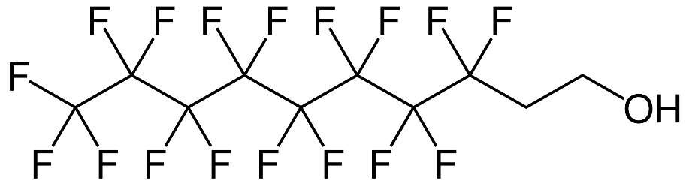
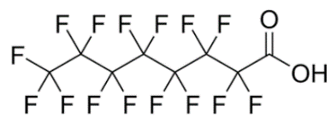
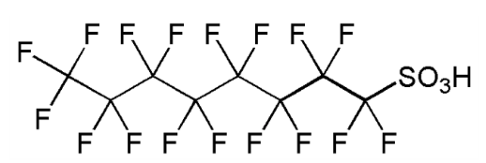
What are PFAS?
PFAS
Poly-PFAS
PFCAs
PFSAs
PFOA
PFOS
Per-PFAS or “PFCs”
PFAAs
FASAs
Per- and Polyfluoroalkyl Substances
Perfluoroalkane sulfonamides
Perfluoroalkyl Acids
Perfluoroalkylcarboxylic acids
Perfluorinated sulfonic acids
Notes:
PFAS is the collective acronym for per- and polyfluoroalkyl substances. Of the per-PFAS, PFAAs or perfluoroalkyl acids are particularly prominent in the environment, especially PFOS and PFOA.

Slide 8
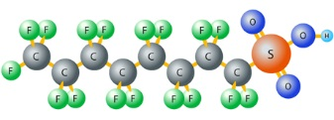
What are PFAS?
Large class (5,000+) of anthropogenic compounds
Commercial analytical methods detect ~24 PFAS
Tail - carbon chain with fluorine substituting some/all of the hydrogens on the chain (hydrophobic and oleophobic)
Head – Polar functional group (hydrophilic)
Unique surface active properties – leads to partitioning at interfaces (e.g., soil/water, water/air, water/NAPL)
Notes:
There are over 4000 anthropogenic compounds and only about 24 of them can be detected by commercial analytical methods. The carbon chain has a tail end that is hydrophobic (water repelling) and oleophobic (oil-repelling) and a head end that is hydrophilic (water-loving). Because of these multiple properties found in one molecule, we see unique surface-active properties leading to partitioning at the soil/water interface.

Slide 9

Per-PFAS versus Poly-PFAS
Per-PFAS | Poly-PFAS
Fully fluorinated | Not fully fluorinated
Strong C-F bond | Creates a “weak link”
Difficult to degrade | Can be transformed into Per-PFAS
High water solubility | Low water solubility
Low volatility | High volatility
Transported in surface & groundwater | Transported in atmosphere
Notes:
So, what is the difference between per- and poly-PFAS and what does that mean for their fate and transport in the environment? To understand that, we’ll need to look at the molecules. Per-PFAS are fully fluorinated which means that they have fluorine atoms attached to all bonding sites along the carbon chain except where the functional group is attached as shown in this diagram. Carbon-fluorine bonds are very strong and difficult to degrade. Thus per-PFAS is very persistent in the environment. Poly-PFAS, however, are not fully fluorinated, which means an atom other than fluorine is attached to at least one of the bonding sites. This bond creates a “weak link” in the chain that is more likely to degrade. Because of this, poly-PFAS have the potential to be transformed into per-PFAS. These differences between the molecules affect how they move through the environment. Per-PFAS have high water solubility and low volatility, allowing them to be easily transported in surface and groundwater. Poly-PFAS, on the other hand, have low water solubility and high volatility, allowing them to easily move through the atmosphere. And since poly-PFAS can be transformed into per-PFAS, this could be one reason why PFOS and PFOA (both per-PFAS) have been found in remote areas far from known sources even though neither of them is volatile. It appears that poly-PFAS can travel long distances through the atmosphere to somewhere far from the source. They are then eventually degraded into per-PFAS. This relationship between per- and poly-PFAS is important when considering “background” contamination and source identification.

Slide 10
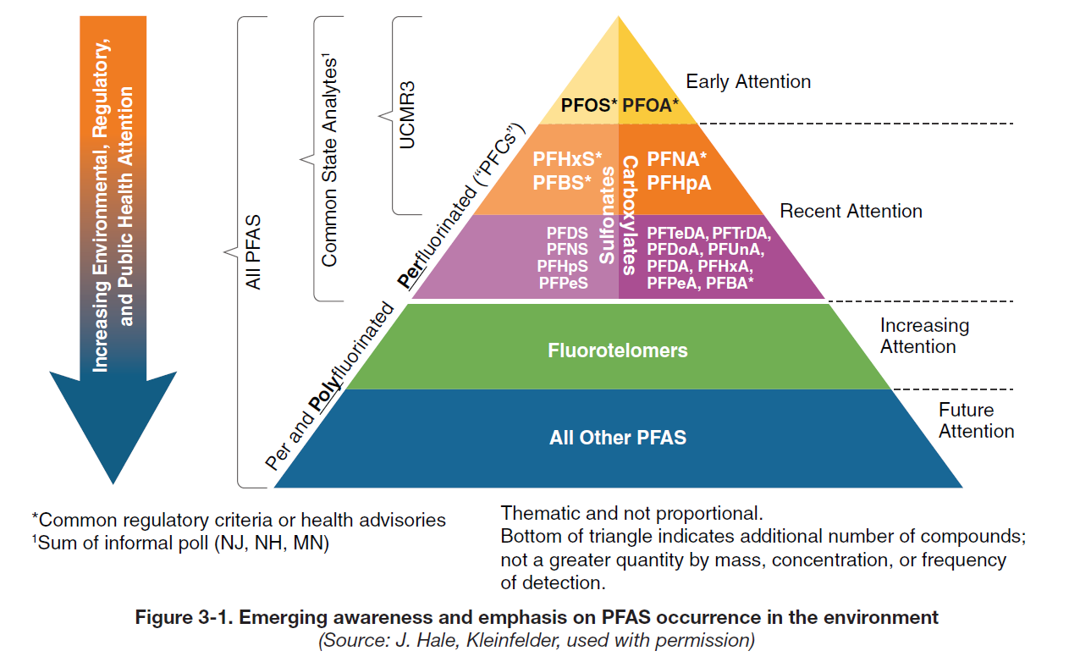
Emerging Awareness
SOURCE: ITRC’s History of Use of Per- and Polyfluoroalkyl Substances (PFAS) – Fact Sheet
Notes:
As most of you know, PFAS have been rapidly gaining recognition as contaminants of emerging concern. The initial focus was on longer chain compounds such as PFOA and PFOS. Use of these compounds have since been phased out. In 2016, the EPA issued Lifetime Health Advisories for both PFOA and PFOS of 70 parts per trillion in drinking water. But as you can see from this figure, this is just the tip of the PFAS iceberg. Other perfluorinated compounds and polyfluorinated compounds have started to and will continue to gain attention. Some of these newer compounds were introduced as replacement chemicals. For example, GenX was introduced to replace PFOA.

Slide 11
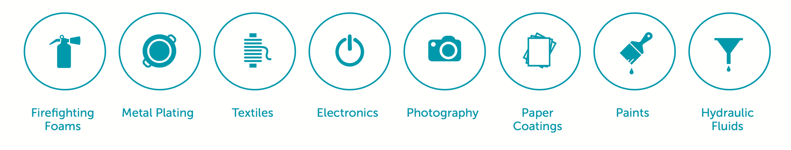
Where do PFAS come from?
PFAS exposure may:
Affect development in children
Lower pregnancy chance
Interfere with hormones
Increase cholesterol levels
Affect immune system
Increase risk of cancer*
Note: regulatory standards are based on animal studies; human studies have been inconclusive.
* - Cancer risk is still a matter of debate.
SOURCE: CDC/ATSDR PFAS Health Effects; http://evocra.com.au
Notes:
PFAS have been in use since the 1940s and come from a wide range of sources such as household products, firefighting foams, and industrial processes. They are known to bioaccumulate in environment and in the human body, which may cause health problems such as infertility, developmental problems in children, and cancer.

Slide 12
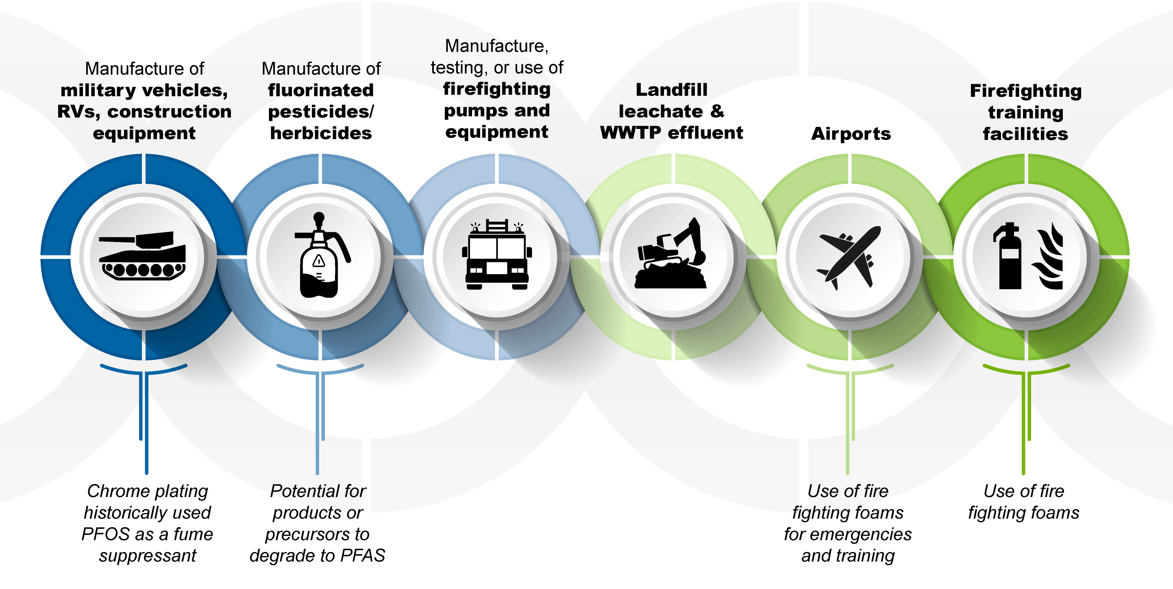
Sources from Manufacturing
No natural sources
Notes:
Manufacturing industries are a key contributor of PFAS to the environment. Processes in these industries can generate PFAS in landfill leachate, wastewater treatment plant effluent, airports, and firefighting training facilities.

Slide 13
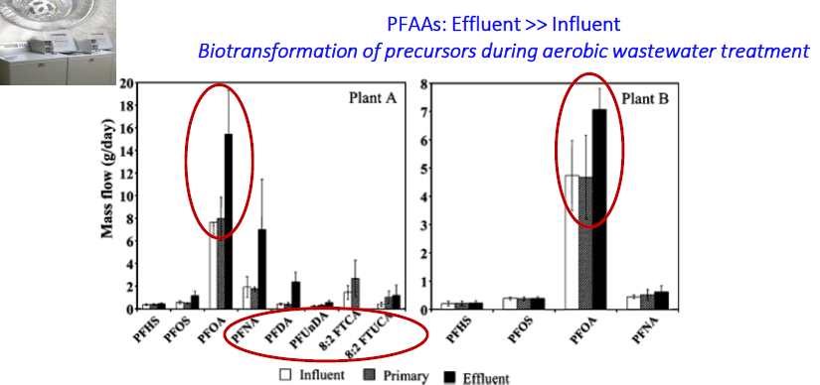
PFAS in Wastewater
SOURCE: Schultz et al. (2006) Environ. Sci. & Technology 40(5)

Slide 14
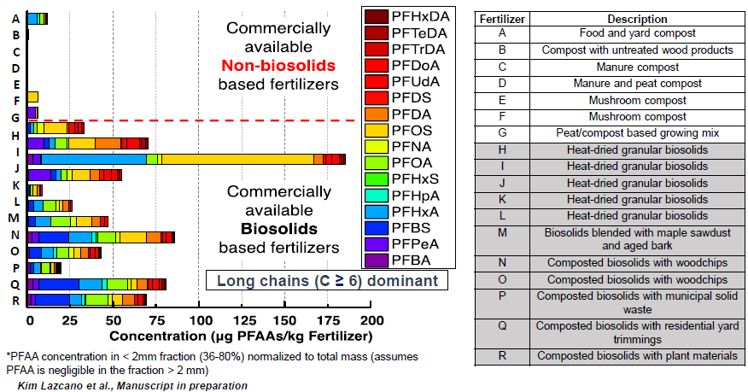
PFAS in Commercial Fertilizers
SOURCE: Lazcano et al., Manuscript in preparation

Slide 15
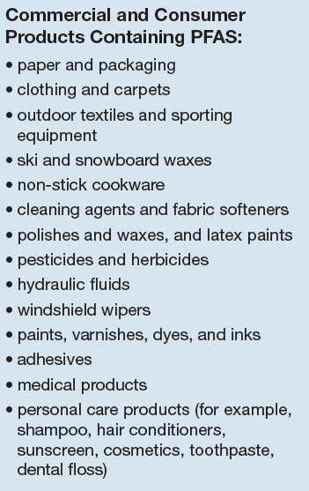

Potential Exposure Pathway
SOURCE: www.atsdr.cdc.gov/pfas
SOURCE: ITRC – History and Use of PFAS Fact Sheet 2017
Notes:
Aside from processes in manufacturing industries, many commercial and consumer products have and still may contain PFAS. Of particular concern are food packaging. Until recently, eating food packaged in materials containing PFAS (such as popcorn bags, fast food containers, and pizza boxes) had been a significant exposure pathway. Thankfully, the use of PFAS compounds in food packaging have been largely phased out. Other exposure pathways include hand-to-mouth transfer from surfaces treated with PFAS (in babies and children) and dermal exposure. All in all, there are many ways that PFAS can get into our bodies.

Slide 16
PFAS timeline
2019 USEPA releases PFAS Action Plan
2018 USEPA issues draft toxicity criteria for GenX PFAS compounds
2018 ATSDR releases draft Toxicological Profile for Perfluoroalkyls
2010
2016 USEPA issues Drinking Water Health Advisories for PFOA and PFOS
2010 Health Canada issues provisional drinking water guidance values for PFOS and PFOA
2009 PFOS added to Annex B of the Stockholm Convention on persistent organic pollutants
2009 USEPA Preliminary Drinking Water Health Advisory for PFOA/PFOS
2006 McDonald’s phases out fluorotelomers in packaging
2000
2006 USEPA PFOA Stewardship Program established
2003 China and Brazil scale-up production
2001 3M ceases production of PFOS and related compounds
1990
Late 1990s Widespread occurrence of PFOS/PFOA in blood of the general population
Late 1990s Improved analytical capabilities for detecting low concentrations
1960
1961 DuPont research suggest negative health effects on mice fed PFOA
1950
1951 DuPont begins using PFOA to make Teflon; first use of PFAS as a wetting agent and fume suppressant in chrome plating industry
1940
1947 3M begins production of PFOS and PFOA

Slide 17
Why are PFAS a concern?
SOURCE: Hu, Xindi C., et al. "Detection of poly-and perfluoroalkyl substances (PFASs) in US drinking water linked to industrial sites, military fire training areas, and wastewater treatment plants." Environmental science & technology letters 3.10 (2016): 344.
Notes:
So why is everyone so concerned about PFAS? If it’s been phased out of food packaging and consumer goods, what’s the problem? One significant exposure pathway for PFAS is through drinking water. Researchers analyzed EPA data collected under the Safe Drinking Water Act Unregulated Contaminant Monitoring Rule (UCMR3) which looked at the drinking water supply of communities across the country. The blue colored areas show where PFAS was detected in the water supply. As you can see, there was widespread detection of PFAS and concentrations were higher in watersheds containing industrial sites, military fire training areas, AFFF certified airports, and wastewater treatment plants compared to watersheds that did not contain these point sources.

Slide 18
Exceedances of EPA’s Drinking Water Health Advisory
US EPA’s Health Advisory is 70 ng/L or ppt
SOURCE: Hu, Xindi C., et al. "Detection of poly-and perfluoroalkyl substances (PFASs) in US drinking water linked to industrial sites, military fire training areas, and wastewater treatment plants." Environmental science & technology letters 3.10 (2016): 344.
Notes:
These two maps show where concentrations of PFOS (top) and PFOA (bottom) exceeded the EPA’s health advisory level of 70 ppt. The results of this study revealed that the drinking water supply of 6 million US residents had PFOS and/or PFOA concentrations greater than the EPA’s health advisory.

Slide 19
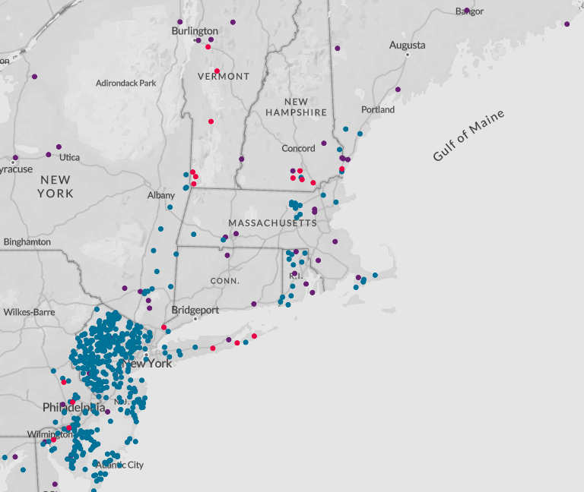
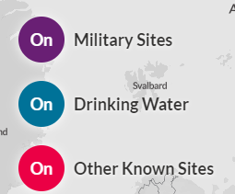
PFAS in the Northeast – Environmental Working Group Map
Notes:
EWG is a non-profit activist group – the few CT sites (Greenwich, Windsor Locks, Groton Sub Base) are now shown on the map

Slide 20
Which PFAS to regulate?
Region | PFOA | PFOS | PFNA | PFBA | PFBS | PFHxS | PFHpA
USEPA | Yes | Yes
PA | Yes | Yes
AK | Yes | Yes | Yes |  | Yes | Yes | Yes
CA | Yes | Yes
MI | Yes | Yes | Yes |  | Yes | Yes
MN | Yes | Yes |  | Yes | Yes | Yes
CT | Yes | Yes | Yes |  |  | Yes | Yes
Australia | Yes | Yes |  |  |  | Yes

Slide 21
Advisory/Guidelines
To be updated to reflect most recent information
Jurisdiction | Drinking Water/ Groundwater | Surface Water | Soil to Groundwater (Screening) | Soil Human Health (Screening)
US EPA | HA / SL |  | Yes | Yes
Alaska | AL / CL | AL | Yes | Yes
California | RL
Colorado | CL
Connecticut | AL
Delaware | RL / SL |  |  | Yes
Iowa | CL |  |  | Yes
Maine | SL / CL | SL | Yes | Yes
Massachusetts | GL
Michigan | CL / SL | Yes | Yes | Yes
Minnesota | CL |  |  | Yes
AL – Action Level
CL – Cleanup Level
GL – Guidance Level
HA – Health Advisory
IL – Initiation Level
MCL – Maximum Contaminant Level
RL – Reporting Level
SL – Screening Level
WQS – Water Quality Standard
SOURCE: ITRC PFAS Fact Sheet Tables August 2019

Slide 22
Advisory/Guidelines
To be updated to reflect most recent information
Jurisdiction | Drinking Water/ Groundwater | Surface Water | Soil to Groundwater (Screening) | Soil Human Health (Screening)
Montana | WQS
Nevada | WQS |  |  | Yes
New Hampshire | WQS |  |  | Yes
New Jersey | MCL / WQS
New York | Yes
North Carolina | CL |  | Yes | Yes
Oregon | IL | Yes
Rhode Island | WQS
Texas | CL |  | Yes | Yes
Vermont | HA / CL
Wisconsin | Yes
AL – Action Level
CL – Cleanup Level
GL – Guidance Level
HA – Health Advisory
IL – Initiation Level
MCL – Maximum Contaminant Level
RL – Reporting Level
SL – Screening Level
WQS – Water Quality Standard
SOURCE: ITRC PFAS Fact Sheet Tables August 2019

Slide 23
Drinking Water Advisory / Guidelines
As of April 30, 2019
Jurisdiction | PFOA (ng/L or ppt) | PFOS (ng/L or ppt) | Other (ng/L or ppt)
US EPA | PFOA + PFOS 70
Alaska | Sum of 5 PFAS 70 |  | PFBS | 2,000
California | 14 | 13
Connecticut | Sum of 5 PFAS 70
Maine | PFOA + PFOS 70
Massachusetts | Sum of 5 PFAS 70 |  | PFBS | 2,000
Michigan | 9 | 8 | PFNA PFHxS PFBS | 9 84 1,000
Minnesota | 35 | 15 | PFBA PFBS PFHxS | 7,000 2,000 47
Nevada | 667 | 667 | PFBS | 667,000
New Jersey | 14 | 13 | PFNA | 13
North Carolina |  |  | Gen-X | 140
Rhode Island | PFOA + PFOS 70
Vermont | Sum of 5 PFAS 20
SOURCE: ITRC PFAS Fact Sheet Tables April 2019
Notes:
Let’s take a look at the current drinking water guideline levels for PFAS. Most levels that have been published for drinking water focus on PFOA and PFOS, but there are some for other PFAS compounds. As you can see, there is a large variation in advisory levels between states. Most states have adopted the EPA Health Advisory Level of 70 ppt, though some have decided to use more stringent guidelines. Not all states currently have criteria; however, most are in the process of developing one. The ITRC currently publishes updates to the state guidelines each month.

Slide 24
Drinking Water Advisory / Guidelines
Note = advisories/guideline are part per trillion (ppt)
Orders of magnitude lower that the typical contaminants encountered
1 ppt = 1 second in 31,700 years
6 inches in the distance from here to the sun
1 drop of water in 20 Olympic-sized pools
(*NWRA April 2019 Issue Brief: PFAS)
Notes:
3.5 drops per pool = 70 ppt

Slide 25

Sampling and Analytical Challenges

Slide 26

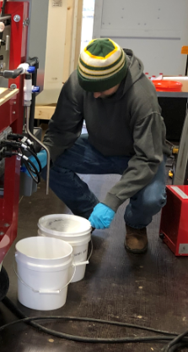
Sampling Challenges
PFAS are ubiquitous
Can be on samplers clothing, gloves,
sampling equipment
Waterproof field note books
Glass bottles can cause loss of analyte
Water for blanks (must be certified-PFAS free)
Notes:
Now for some of the sampling challenges for PFAS. Again they are everywhere, which means that they can be on the sampler who is in the field collecting samples. Some of the commonly used sampling equipment that is Teflon or clothing that has water resistant coatings not appropriate for these sampling events. The bottles used for collection must be HDPE or high density polyethylene materials. No glass bottles are used due to potential of these compounds sticking to the glass and resulting in lower sample concentrations. Any water for blanks, such as field or equipment blanks, must be certified PFAS free water documented through a certified lab. We cannot assume that distilled water is PFAS free. Additionally, field reagent blanks are collected to determine if method analytes are present in the field environment.
The low levels of the 70 ppt advisory really requires us to be stringent in our approach to sample. Until more research is done on sampling materials and techniques, we will continue with conservative sampling methodologies to assure that the data we report is accurate and representative of the Site.

Slide 27
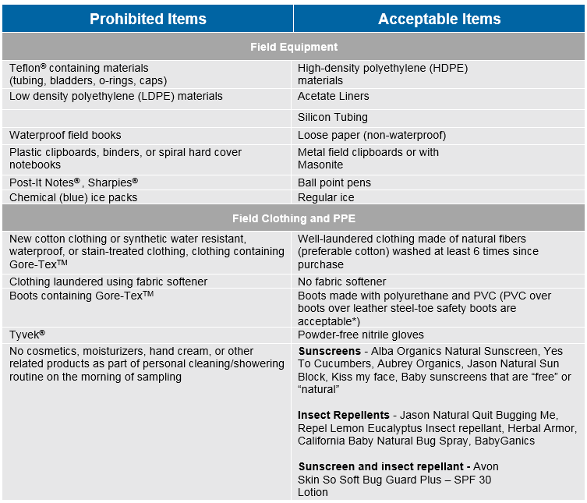
Sampling Challenges
Notes:
At GHD, we have gathered the best available PFAS sampling practices from the literature. This table show a few of the prohibited items (on the left) vs. acceptable (right) items required for PFAS sampling events. The point is that we need to be extremely cautious on how we plan for this sampling events. Now, as more of a disclaimer, it is noteworthy to mention that the available best practices for PFAS sampling lack the research to validate some of the certain equipment or materials will leach PFAS. But again, until more research is available, we will continue to be extra conservative. As a rule of thumb, if you have question about the equipment, it’s best to pull the MSDS to determine chemical composition.

Slide 28

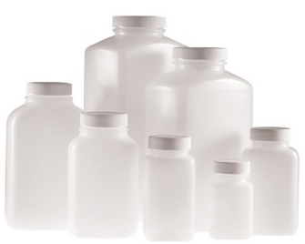
Analytical Challenges
USEPA Method 537.1: Determination of Selected Perfluorinated Alkyl Acids in Drinking Water by Solid Phase Extraction and Liquid Chromatography/Tandem Mass Spectrometry (LC/MS/MS) – November 2018 (revision 1 of Method 537)
  Applies to drinking water
  Originally 14 analytes, now 18 analytes to include GenX chemicals
    Labs can analyze for other PFAS compounds with available standards (28 analytes for most labs)
  Sample preparation can vary
    Solid phase extraction with methanol elution
    Direct methanol-water extraction
  Does not quantitate branched isomers with straight-chained isomers
    PFOS is a mixture of both and have different responses
    Calibration with straight-chained PFOS only can yield up to 40% error in the analysis of “real-world” mixed isomer samples

Slide 29
Analytical Challenges – Draft SW-846 Methods
  EPA SW-846 Method 8327: Per-and Polyfluoroalkyl Substances (PFAS) Using External Standard Calibration and Multiple Reaction Monitoring (MRM) Liquid Chromatography/Tandem Mass Spectrometry (LC/MS/MS)
    Applies to groundwater, surface water and wastewater
    24 PFAS Compounds
    Method validation published in June 2019
EPA SW-846 Method 3512: Per- and Polyfluoronated Alkyl Substances (PFAS) in Non-potable Water by Solvent Dilution
    Currently an appendix to Method 8327
    Expected to become a standalone method
    Microscale preparation of dilute samples to minimize sample size and solvent usage

Slide 30
Analytical Challenges
Development of other EPA Methods
  Draft EPA Method 533
    Method specific to short chain PFAS
      <12 carbons
      Will include a total of 25 PFAS
  Draft SW-846 Method 8328 - Isotope Dilution
    Will apply to solid, surface water, groundwater and wastewater matrices
    Same 24 PFAS analytes plus GenX
    More robust for complex matrices
Notes:
Lack of standards for specific compounds limits the ability of labs to expand the analyte list.

Slide 31
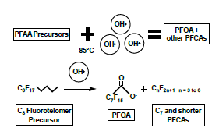
TOP Assay
Total Oxidizable Precursor (TOP) Assay
  Developed by TestAmerica
  Oxidizes polyfluorinated compounds to perfluorinated compounds
  Estimate of total concentration of PFAS precursosrs
  Uses hydroxyl radical oxidation under high temperature
  More expensive – PFAS analysis done twice (before and after oxidation)
  Can be used on solid and aqueous matrices
  Under evaluation by EPA, but no standard method exissts
SOURCE: TestAmerica SERDP Poster 2017
Notes:
The TOP assay forces an oxidization step and artificially drives the poly FCs to become per FCs. We have seen in Australia PFAS samples where the standard analysis indicated no PFOA or PFOS, but the TOP assay results created a number of them. So the TOP results are used qualitatively in risk assessment to get a bit more of an understanding of the potential risk of the PFAS mass that we otherwise haven’t identified and don’t know anything about.

Slide 32
Overview of CT’s PFAS Action Plan

Slide 33
CT Chapter AHMP
December 4, 2019
Notes:
Commissioners

Slide 34
Agenda
Action Plan Time Line
PFAS Task Force Action Plan Items
Drinking Water Actions
Public Comment Summary
Next Steps
Notes:
Important to note the Public comment period at approximately 2:40. Please sign up now with Alison.

Slide 35
PFAS Task Force Initiated by Governor Lamont
July 8, 2019 Letter
Develop a State Agency Task Force
Identify impacts to human health and environment
Listen to stakeholders
Identify actions to address impacts
3 Focus Areas: - Human Health, Pollution Prevention, and Remediation. Common element: communication
New and challenging contaminant

Slide 36
Action Plan Timeline
Meeting 2
Working session: review committee progress and provide input
8/28
Task Force chairs submit DRAFT PFAS Action Plan to Governor Lamont
10/1
Governor Lamont orders formation of Task Force
7/8
Meeting 1
Convene Task Force and establish committees
7/30
Meeting 3
Review and assemble final Action Plan draft
9/18
Final
PFAS Action Plan to Governor Lamont
11/1
Week of 8/12
Committees meet to outline proposed actions
Week of 9/9
Committees draft Action Plan sections
Opportunity for Public Comment
Notes:
Note: Plan will be issued in Draft form on 10/1 with a public comment period to follow. The final PFAS Action Plan is now due to Governor Lamont on November 1, 2019.

Slide 37
ACTION PLAN
RECOMMENDATIONS

Slide 38
Human Health Committee
Key Take-Aways
Communication: Clear and Understandable Information for all stake holders
Science based decision making
Need for testing drinking water, fish, shellfish, agricultural products and other consumer products
Laboratory capacity and standard methods
Notes:
We had two productive meetings and have considered the input from the over 70 participants

Slide 39
Action Plan: Strategic Focus 1 Human Health
Protect the Health of CT Citizens
Drinking Water Testing
Identification of Sources of Human Exposure
Evaluation of Laboratory Capacity
Effective Communication and Technical Assistance
Safe Drinking Water Advisory Council for MCL
Notes:
CT Public Health Laboratory, CT Agricultural Experiment Station, Center for Environmental Sciences and Engineering at UCONN, Yale University
people who submitted and presented
Lessons Learned-After Action
Sources of Human Exposure:
Dairy and agricultural products, fish, shellfish, food service ware-Sherrill Baldwin DEEP

Slide 40
Drinking Water Testing
Phased approach
Vulnerability Land Use Risk Assessments
Circular Letters 2018-19 & 20
Standard method & procedure
Science based decision making
Laboratory capacity and standard methods

Slide 41
Safe Drinking Water Advisory Council
Advisory to the Commissioner of DPH
Modelled after other states: NY, NJ, NH
Experts from a variety of related disciplines
PFAS Action Level

Slide 42
Importance of Risk Communication
Work with Local Health Directors
Share data in plain language
Share data quickly and effectively with water utility customers and all stakeholders
Norwalk and Greenwich are excellent examples

Slide 43
Action Plan : Strategic Focus 2
Pollution Prevention
Determine universe of potential sources
Initiatives to minimize future release of AFFF
Establish discharge limits
Evaluate biosolids and compost as potential sources
Consider PFAS-free consumer products for State procurement contracts
Notes:
Determination of the universe of potential PFAS sources by:
Identifying the operations and processes that may be sources of PFAS contamination. These may include but are not limited to metal plating facilities, car washes, land-applied biosolids, firefighting training facilities, landfills, waste-to-energy facilities, and spills and incidents where AFFF was used.
Identifying the consumer products that may contain PFAS. These may include but are not limited to food packaging, nonstick cookware, cleaners, waxes, and coated fabric and paper.
Initiatives to minimize future releases of AFFF to the environment:
Legislation to establish an AFFF take-back program for state agencies and municipal fire departments.
Evaluation, selection, and procurement of fluorine-free alternative foams for Class B flammable liquid fires.
Development and implementation of best management practices for the handling and storage of AFFF concentrate, management of released AFFF, and disposal of associated impacted media.
Future legislation that would reduce future releases of AFFF to the environment, such as a ban on firefighting training with AFFF.
Establishment of standards and discharge/emission limits for PFAS in air, surface water, and wastewater.
Recommendation of state-sponsored baseline sampling at wastewater treatment plants.
Evaluation of biosolids’ PFAS levels and ultimate use and/or disposal.
Evaluation of PFAS levels in compost derived from food waste that included compostable food containers, disposable cutlery, and/or PFAS-treated paper products.
Consideration of PFAS-free consumer products for procurement by State agencies, such as cleaning products, food service ware, and food packaging.
Establishment of an ad hoc group to review the most current research and nationwide actions regarding PFAS in food packaging and consumer products.
Continued involvement with NEBRA, NEWMOA, NEIWPCC, and interaction with regional state agencies.

Slide 44
Action Plan: Strategic Focus 3
Remediation
Develop GIS database of sources
Develop sampling strategy for environmental media
Sampling at landfills, airports, firefighter training facilities
Establish standards for surface water and aquatic biota
Collaborate with stakeholders on remediation technology
Notes:
Development of an Interagency GIS database that identifies the universe of potential source sites and threatened receptors.
Development and implementation of a strategy for random and targeted sampling of environmental media and aquatic organisms to determine ambient conditions and identify impacted areas. Consult with federal agencies and other parties conducting environmental sampling to share information on sample locations and analytical results.
Environmental sampling at landfills on a tiered approach, prioritizing sampling at landfills with human receptors nearby.
Environmental sampling at airports where AFFF has been stored or released.
Environmental sampling at fire departments and firefighting training facilities where AFFF has been stored or released.
Establishment of PFAS cleanup standards for direct exposure to soil, soil leaching to groundwater, groundwater, surface water, and aquatic biota.
Continue to compel the investigation and cleanup of PFAS releases through existing statutory authority.
Continued involvement with regional state agencies and groups including NEWMOA, EPA Region 1, ECOS, NEIWPCC, and the Interstate Technology and Regulatory Council (ITRC) to share information related to PFAS sites, fate and transport, and remediation.
Collaboration with university researchers, environmental consultants, and others to keep abreast of emerging technologies for PFAS detection and cleanup and to evaluate the efficacy and applicability of such technologies in Connecticut.

Slide 45
Action Plan: Strategic Focus 4
Cross Cutting Actions
Enhance education outreach and communication
Public outreach team
Collaborate with local emergency responders
Continue networking with other state, regional and national groups
Notes:
Education, outreach, and communication
Establishment of a public outreach team consisting of DEEP and DPH personnel along with representatives of other state agencies as needed. On a case-by-case basis, this group may also include local officials. This team would provide risk communication to the public in response to environmental incidents that pose a real or perceived threat to human health. Team members would provide a variety of risk communication services, such as communications templates, physical canvasing of affected areas, printing and circulation of informational newsletters, and/or hosting of public meetings.
Collaboration with local emergency response personnel and utilization of existing communication plans to effectively disseminate information and inform the public.
Continued participation in regional and national workgroups, conferences, and training opportunities. These interactions provide the State Agencies with knowledge of the challenges facing states where PFAS contamination has been identified and the actions that these states are taking to address them.
Development and publication of a natural resources, human health, and financial impacts report that records past, existing, and future actions taken in Connecticut to address PFAS.

Slide 46
Public Comment Summary
October 1 – 15, 2019 comment period
293 comments from over 400 commenters
Evaluated each and every comment
Comments are wide-ranging
Overall support for the draft action plan recommendations

Slide 47
Next Steps

Slide 48
Treatment Challenges

Slide 49
Whole Site View
PFAS mg/kg
PFAS source zone
PFAS ug/L
- Monitoring & natural attenuation
- Interception or hydraulic control
Containment
Removal
Treatment ex situ
Treatment in situ
N
Groundwater pathway
Risk Assessment
Water
Treatment
Institutional controls
Alternate supply
Stakeholder engagement
Hydraulic controls
Water treatment
Secondary source removal
Surface water pathway
Receptors
49

Slide 50
Remedial Trends
  Risk Management
  Drinking Water Management/Treatment
  Source Removal/Incineration
  Containment/Mitigation
  Many Research Studies, Trials and Progress (e.g., in situ thermal, and soil washing)
50

Slide 51
Typical Risk Assessment Supporting Remediation
Human Health
  Potential effects to workers from soil, groundwater and surface water
Ecological
  Soil, groundwater, surface water, and biota, with bioaccumulation assessment by food web modeling
  High potential for unacceptable risks (birds and mammals for this particular site) in highly impacted habitat areas (e.g., ponds)
  Low potential from larger surface water bodies
  Remediation and management, including:
    Alternative water supply and/or treatment
    Remove heavily impacted soils
    Surface water diversion
    Monitoring to determine if concentrations are stable, increasing, decreasing
51

Slide 52
Typical Eco Risk Assessment Supporting Remediation
Ecological
  Soil, groundwater, surface water, and biota, with bioaccumulation assessment by food web modeling
  High potential for unacceptable risks (birds and mammals for this particular site) in highly impacted habitat areas (e.g., ponds)
  Low potential from larger surface water bodies
  Remediation and management, including:
    Source removal and habitat management
    Limit impacted surface water discharges
    Monitoring to determine if concentrations are stable, increasing, decreasing
  Fish advisories are conservative
52

Slide 53
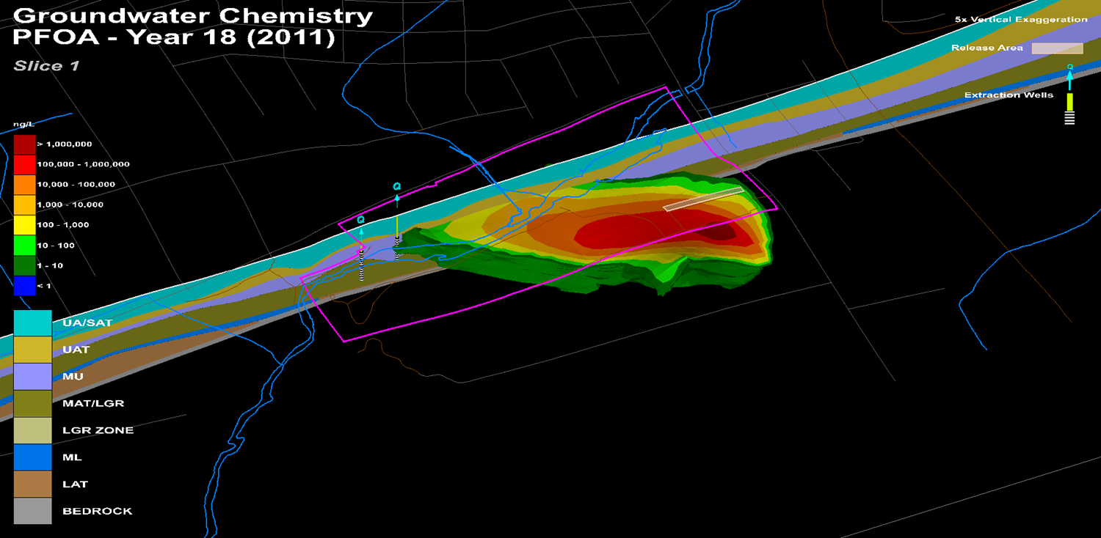
Fate and Transport
Video

Slide 54
Remediation Challenges – PFAS
Biodegradation
Very limited research to date showing biodegradation of Per-PFAS
Evidence of transformations of Poly-PFAS
Unknown ability to treat to the proposed standards?
Oxidative / Reductive Technologies
Requires high energy and/or diverse reactive species – complex chemistry
Several bench studies and few pilots performed showing destruction of PFAS
Research is ongoing to treat precursors
SOURCE: XDD Environmental – PFAS Remediation Webinar – Part 1
Notes:
For biodegradation, there is very limited research in this area which really affords for new opportunities to improve the technology. There is some evidence of transformations of poly-pfas, but again very limited. One of the to be answered questions about biodegradation is will the technology be able to treat to the proposed standards.
For oxidative and reductive technologies, these approaches require high energy and reactive species such persulfate or hydroxyl radicals. And truly the chemistry can be complex which can result side-reactions that need to be characterized. I can tell you from first hand experience that research is ongoing in this area.

Slide 55
Treatment Options – Soil / Infrastructure
Excavation and incineration
  High temperatures and off gas treatment required to destroy PFAS
  Requires high temperature incinerators
  Approach is very high cost and ‘less than environmentally sustainable’
On-site stabilization
  e.g., stabilization with products such as Rembind or Activated Carbon
  Does not destroy PFAS
On-site containment
  On-site landfill construction
  Does not destroy PFAS

Slide 56
Incineration of PFAS
Limited scientific literature
Fluorinated byproducts may be formed when incinerating PFOS (Yamada & Taylor 2003)
  At 600°C, incineration of PFOS-contaminated material resulted in many byproducts
  At higher temperatures (750°C and 900°C), these byproducts were not observed
Current best practice disposal routes for spent PFAS adsorption media are incineration at temperatures >1000°C

Slide 57
Evaluation of Water Treatment Technologies
<10% | 10-90% | >90%
 | AER | COAG/DAF | COAG/ FLOC/SED/G- or M-FIL | MnO₄, O₃, ClO₂, Cl₂, CLM, UV | AIX | GAC | NF | RO
PFBA | * | *
PFPeA
PFBS
PFHxA
PFHpA
PFHxS
PFOA
PFNA |  |  |  |  | * | *
FOSA |  |  |  |  |  | * |  | *
PFOS
PFDA |  |  |  |  | * | *
N-MeFOSAA | * |  |  |  | * | * | *
N-EtFOSAA |  |  |  |  | * | * | *
INCREASING SIZE
*Treatment performance is assumed based on PFAA size/charge and/or known removal data of shorter or longer chain homologues
SOURCE: Dickenson and Higgins (2016) Water Research Foundation “Treatment Mitigation Strategies for Poly- and Perfluoroalkyl Substances”
Notes:
Research on optimal treatment technologies of PFAS in water is ongoing. Of particular interest, is a study completed by the Water Research Foundation in 2016 evaluating 15 full-scale treatment systems throughout the U.S. (including two potable reuse treatment systems) for attenuation of PFAS. PFAS concentrations were measured in source waters located in ten different states and included surface water, groundwater, and treated wastewater. Source waters had PFAS concentrations ranging from 0.25 ppt to 370 ppt which is above the advisory level set by the EPA. Grab samples were taken before and after each treatment process for the study. Hopefully, those of you in the back can see this. I’ve color coded the removal efficiencies of the treatment methods with yellow being a removal efficiency of less than 10%, green being 10-90% and blue being greater than 90%. The study looked a wide range of treatment methods. Across the top, in the first four columns, we have aeration, coagulation/dissolved air floatation, coagulation/flocculation/sedimentation/granular or microfiltration, and oxidation/aeration/disinfection, which are all conventional treatment technologies commonly used by municipal and industrial facilities. Then we have more advanced technologies including anion exchange, granular activated carbon filtration, nanofiltration, and reverse osmosis. Down the left we have a the list of the 13 PFAS that were included in the study in order of increasing size, with the shorter chain compounds on the top and the longer chain compounds on the bottom. As you can see from the results, conventional treatment technologies had limited effectiveness on PFAS removal with less than 10% removed. GAC and AIX were much more effective, removing over 90% of the larger chain PFAS and 10 to 90% of the shorter chain PFAS. NF and RO were the most effective technologies, able to remove even the smallest PFAS chain included in the study. NF and RO are considerably more costly than AIX and GAC and were recommended as treatment strategies if shorter chain PFAS were present in the water. For larger chain PFAS, AIX and GAC were considered adequate treatment methods. However, the study concluded that all four treatments would need further investigation to determine optimal design parameters for PFAS removal, including considerations for disposal of reject streams and resin regeneration.

Slide 58
Ion Exchange
Dual removal mechanism
  PFOS/PFOA negatively charged at the pH of typical natural water
  Hydrophobic end of PFAS can adsorb to hydrophobic surface of resin
Co-contaminants
  Ionic contaminants will compete for IX sites
  Organics can foul resin and require pretreatment
Single use disposed through landfilling or incineration
Regenerable
  Typically done on site
  Must dispose of regenerant solution
Full scale systems in place in the last year or so
Technology providers
  Purolite
  Evoqua
    Dow resin developed for perchlorate

Slide 59
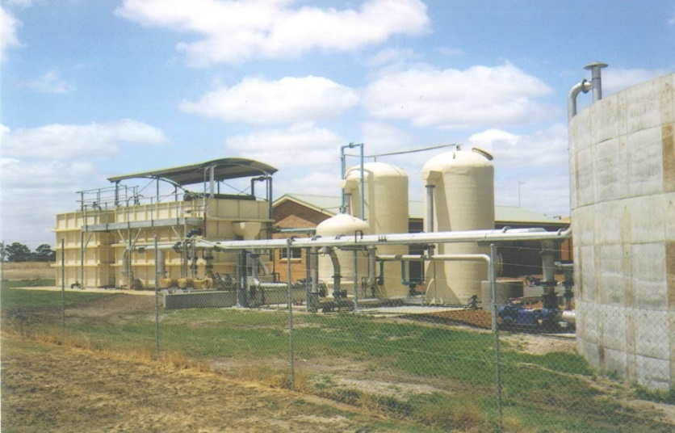
Activated Carbon
Treatment systems for PFAS operating for 15+ years
PFOS removal capacity greater than PFOA
No conversion of precursors to PFAS
Considerations
  Organic concentrations can be 10-100x PFAS and drive carbon usage
  Adsorption media can be thermally reactivated to destroy PFAS
  Each supplier has ~3 locations for incineration
  Some studies show reduced effectiveness with regenerated GAC
  Uncertain if regenerated GAC could be used for drinking water treatment
Technology Providers
  Calgon
  Evoqua

Slide 60
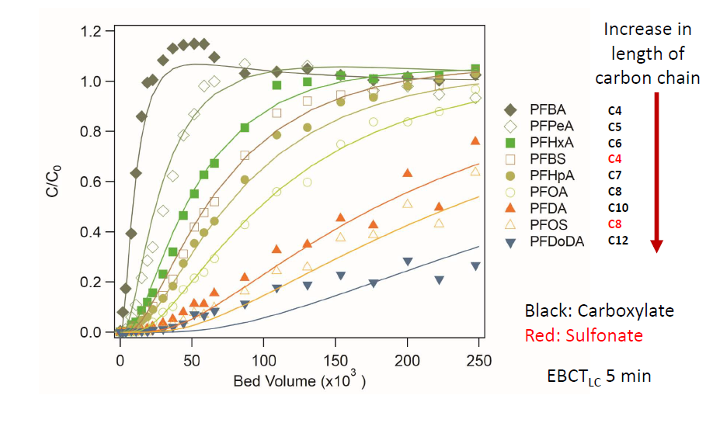
GAC Performance

Slide 61
Developing Technologies
Reverse Osmosis or Nanofiltration
  Bench/pilot studies
  Concentrating the PFAS and other constituents
  Would require further treatment or solidification/stabilization
Rembind©
  Mixture of Powdered Activated Carbon, kaolinite and amorphous aluminum hydroxide
  Bench tests show high removal for PFOS, PFOA and shorter chain
Zeolite/clay adsorption
Advanced oxidation
Advanced reduction
Electrochemical oxidation

Slide 62
GHD Initiatives

Slide 63
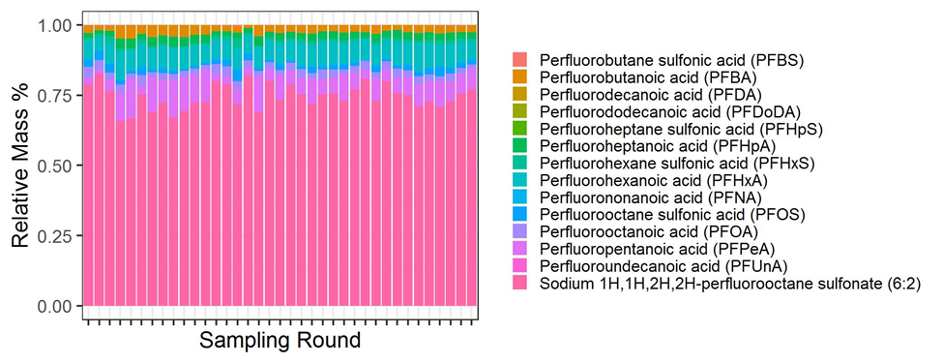
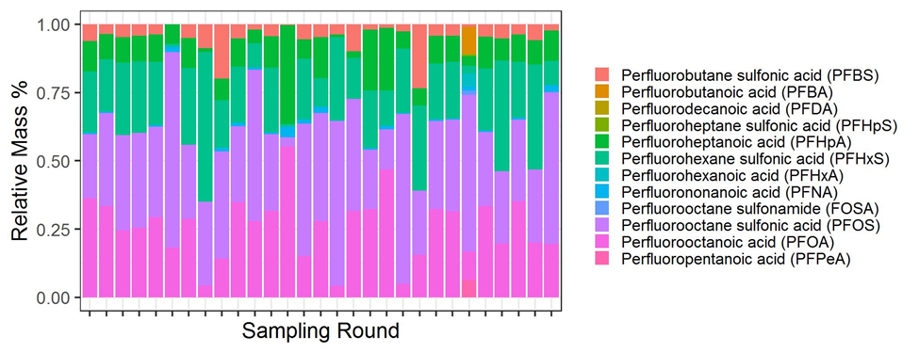
Forensic Analysis - Fingerprinting

Slide 64
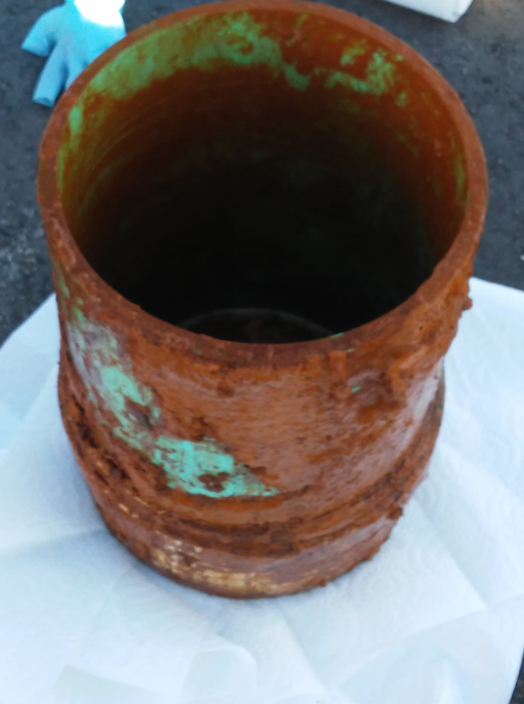
Case Study – Groundwater Treatment
Evaluation of treatment alternatives for
impacted groundwater
Constituents requiring treatment:
    Iron (who doesn’t have iron?)
    Phosphorus (180 ug/L)
    Mercury (8 ug/L)
    PFAS (e.g. PFOS – 750 ng/L)
Constituents potentially requiring pre-treatment:
    Organic carbon (30-50 mg/L)
Removal of non-PFAS organics can drive treatment costs and significantly impact unit process selection
Notes:
GHD is evaluating alternatives for treating the groundwater at a former automobile parts manufacturing facility with hydrocarbon impacts from cutting fluids. While the contamination is mostly hydrocarbons, PFAS has been detected along with metals, and the client is looking to remove them from the groundwater. The dissolved organic carbon content ranges from 30-50 mg/L as carbon (or about 100 mg/L of chemical oxygen demand), which is significantly more than the 1 ug/L or ppb of total PFAS concentration. So when we look at treatment technologies, carbon removal will likely drive costs and treatment selection.

Slide 65
Case Study – Alkaline Ozonation Tests
Treatment includes initial low pH (3 – 4) ozonation, followed by alkaline pH adjustment with hydrogen peroxide ozonation
PFOS and PFOA is non-detect after 1 hour of treatment
Currently testing surfactant properties of PFAS and changing pH that may cause separation in the bench scale tests – Whole Bottle Analysis
Follow-on testing will include spiked certified-PFAS free water
65

Slide 66
Case Study – Michigan Groundwater 1 Alkaline Ozonation Tests
66

Slide 67
On-going GHD Technology Studies
Soil Washing - surfactants
Electrochemical Treatment - minimize cost & formation of byproducts
Adsorption – modified media for drinking water and high strength wastewater
UV/Advanced oxidation - treatment for various impacted water
Soil/Concrete stabilization – reduce leachability
Structural coatings – reduce leachability
Designer Adsorption Materials
Fate and Transport - migration when comingled with other contaminants
Landfill – impacts to soil and groundwater from landfills
Landfill Gas – review thermal treatment technologies
Coagulation technology – to remove PFAS from waste streams
Thermal Treatment – evaluate byproducts, and waste stream management

Slide 68

Last Minute Updates
VT published a study of PFAS background concentrations in soil
  The detected concentrations are greater that proposed cleanup standards, MA has indicated they will reevaluate their proposed numbers
Home improvement stores (Lowes, Home Depot) are phasing out PFAS containing products, e.g. carpets.
Investigative Documentary – The Devil We Know 2018
Dark Waters
starring Mark Ruffalo and Ann Hathaway
  opens on Friday

Slide 69
Questions?
Q

Slide 70

www.ghd.com

