Slide 2
CHMM
Dec 2016
General Meeting
TSCA
RCRA
DOT

Slide 3
RCRA Generator Improvements Rule:
Arguably the two biggest changes in the finalized RCRA Generator Improvements Rule are:
  A wholesale re-organizing and re-structuring of the hazardous waste generator rules in 40 CFR 262 to make the regulations easier to navigate and understand; and
  Providing relief for episodic events that may result in a change of generator status.

Slide 4
More Stringent Requirements for Generators:
Expanding the marking and labeling requirements for hazardous waste containers in satellite and central accumulation areas and for tanks.
Requiring small quantity generators (SQGs) to re-notify EPA (or an authorized State program) once every four years, starting in 2021.
Consolidating and updating the "closure requirements" for hazardous waste accumulation units.
Updating and clarifying the rules for RCRA biennial reporting at 40 CFR 262.41.
Requiring large quantity generators (LQGs) to prepare a quick reference guide for their contingency plans.
Requiring facilities that recycle hazardous waste without storing it to submit a Biennial Report.
EPA is extending the time frame for an episodic event (part 262 subpart L) from the proposed 45 days to 60 days.

Slide 5
Relief Requirements for Generators:
Allowing very small quantity generators (VSQGs) to send their hazardous waste to a large quantity generator under the control of the same "person" as defined at 40 CFR 262.10.
The above-mentioned relief for episodic events to allow VSQGs and SQGs to maintain existing regulatory status.
Allowing LQGs to accumulate ignitable and reactive wastes within the 50-foot facility boundary with approvals from their local fire department.
Changing the term "Conditionally Exempt Small Quantity Generator" (CESQG) to "Very Small Quantity Generator" (VSQG).
Updating and clarifying definitions of critical RCRA terms.
Updating the requirements in 40 CFR 262.11 for making and keeping records of hazardous waste determinations.
Modifying the RCRA requirements for contingency plans for LQGs and SQGs.
Finalizing 20 of 23 proposed technical corrections to the RCRA regulations

Slide 6
Changes to the rules for managing hazardous waste in satellite accumulation areas.
The accumulation limits for acute hazardous waste are 1 quart for liquid wastes or 1 kg (2.2 lb) for physically solid wastes.
Satellite containers are now subject to 1) incompatibility requirements (very similar to those in §265.177); and 2) preparedness, prevention, and emergency/contingency plan requirements that are based on the facility’s generator category (i.e., SQG or LQG).
Satellite containers may also be open 1) when consolidating waste, or 2) when temporary venting is necessary for proper equipment operation or to prevent dangerous situations (e.g., pressure buildups).
Satellite accumulation containers and 90/180/270-day accumulation containers and tanks must be marked/labeled with
  1) the words “Hazardous Waste”, and
  2) an indication of the hazard(s) associated with the contents (e.g., the applicable hazardous waste characteristic(s), a DOT label or placard, an OSHA hazard statement or pictogram, or an NFPA hazard label). Additionally, 90/180/270-day accumulation containers must be marked with the accumulation start date (existing requirement) and, prior to shipment, EPA waste codes.

Slide 7
TSCA Update
New Challenges for Manufacturers and Importers: TSCA Reform

Slide 8
TSCA –
Toxic Substance Control Act
Originally enacted in 1976; Inventory of all chemicals in commerce
For older chemicals, the original law gave EPA extraordinary powers but EPA’s ability to exercise those powers limited by lack of deadlines
Over the years a growing consensus that new chemicals were sufficiently regulated under the law, but most old chemicals were not evaluated by EPA
Original TSCA now modernized with Lautenberg Act

Slide 9
Frank R. Lautenberg Chemical Safety for the 21st Century Act
Reforms the Toxic Substances Control Act (TSCA) Passed House of Representatives May 24th
  Passed Senate June 7th
  President Obama signed

Slide 10
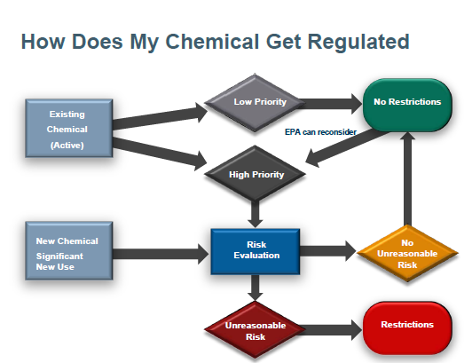

Slide 11
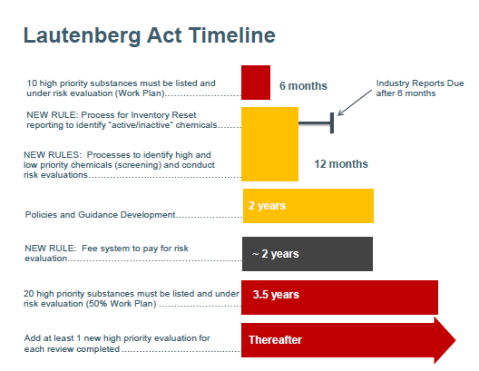
First Ten Priority Chemicals
EPA must identify within 6 months
  Congress set “preferences” for the selection of first 10 High Priority chemicals Score 3 for persistence and bioaccumulation
  Known human carcinogen
  High acute and chronic toxicity
25 chemicals from the 2014 Work Plan that meet at least one of those preferences
https://www.epa.gov/assessing-and-managing-chemicals-under-tsca/highlights-key-provisions-frank-r-lautenberg-chemical

Slide 12
Existing Chemicals -- Inventory “Reset”
Current EPA Inventory developed piece-meal since 1978
▪Within 1 year, EPA must publish Inventory Reset Rule
▪Within 6 months after the Reset Rule, chemical manufacturers must file reports on chemicals manufactured (“active”) over the past 10 years
▪Manufacturers with chemicals on Confidential Inventory must re-designate confidential status to maintain confidentiality (i.e., listing under a generic name)
▪Going forward, notice must be submitted to EPA before “inactive” chemical substance is manufactured or processed (manufacturers and processers)

Slide 13
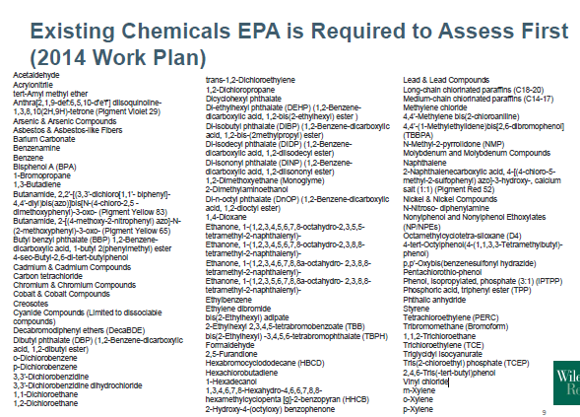

Slide 14
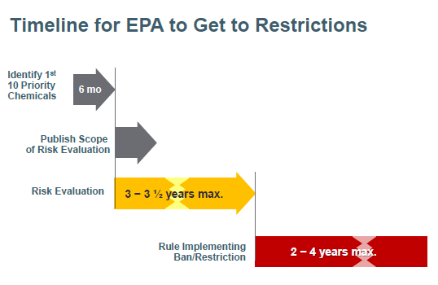

Slide 15
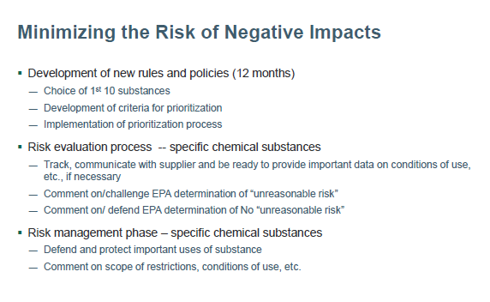

Slide 16
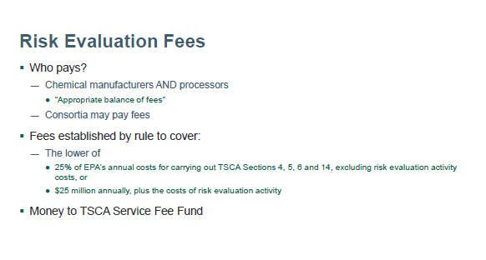

Slide 17
DOT – Lithium Battery Shipping Update

Slide 18
UPS/FedEx
IATA Packaging
  For both Lithium Metal & Lithium-ion Battery
    UN 3090 or UN 3480
  Starting Jan. 1, 2017 – neither company will accept Packaging exception – PI 965 & 970 – Section II
  They will accept them as fully regulated, Class 9.

Slide 19
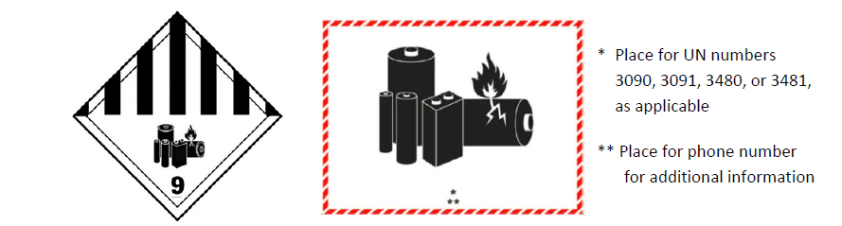
New Class 9 Label
Shippers will have until January 1, 2019 to transition over to the new label and mark, which is consistent with the transition authorized in accordance with the IMDG Code and ICAO Technical instructions.

Slide 20
Amendments to the lithium battery provisions in 49 CFR § 173.185; new Class 9 lithium battery labeling section at 49 CFR § 172.447
An amendment to § 173.185(c)(2) would require that outer packagings used to ship small lithium batteries be “rigid” and of adequate size so the handling mark can be affixed on one side without the mark being folded.
For air transport only, an “OVERPACK” marking would be required for packages that bear the lithium battery mark, placed in overpack, and shipped in accordance with the exceptions in § 173.185(c). (The OVERPACK mark would not be required if the lithium battery mark is clearly visible through the overpack.)
When shipping damaged or defective lithium batteries in accordance with § 173.185(f),the “Damaged/defective lithium ion battery” and/or “Damaged/defective lithium metal battery” marking would need to be in characters at least 12 mm (.47 inch) high.

Slide 21
Amendments to the lithium battery provisions in 49 CFR § 173.185; new Class 9 lithium battery labeling section at 49 CFR § 172.447
Document – no longer required
“no more than four lithium cells or two lithium batteries installed in equipment, where there are not more than two packages in the consignment.”
Definition of Consignment “One or more packages of hazardous materials accepted by an operator from one shipper at one time and at one address, receipted for in one lot and moving to one consignee at one destination address.”

Slide 22
Lithium Batteries shipped by AIR
Significant changes were made to the lithium battery packing instructions in the 2015 –2016 Edition of the ICAO Technical Instructions that went into effect on April 1, 2016.
  These included a prohibition on the transport of lithium ion cells and batteries as cargo on passenger aircraft,
  a 30 percent state of charge limit on lithium ion cells and batteries, and
  restrictions on overpacking Section II lithium ion and lithium metal cells and batteries. These changes are not being proposed at this time in the HM-215N NPRM because PHMSA is considering adopting these amendments in a separate rulemaking.
Expect PHMSA to publish a separate lithium battery NPRM before the end of this year to harmonize with the ICAO Technical Instructions.

Slide 23
Open Discussion

