Slide 1

December 5, 2013
RICE for CTACHMM
General Meeting
By Laura Zadrick, CTACHMM President

Slide 2
RICE
Regulations on Internal Combustion Engines
40CFR60.4200

Slide 3
RICE NESHAP – It’s Complicated
“40 CFR Part 63 Subpart ZZZZ . . . is the most complicated and confusing regulation in the entire suite of EPA NSPS and NESHAPS regulations, bar none. We seriously believe that a viable defense could be mounted against an EPA enforcement action with the simple but true statement, 'Your honor, we honestly could not discern our obligation under the rule in a timely manner.‘”
Public comment submitted in response to EPA’s request for public input on improving regulations per Executive Order 13563

Slide 4
OVERVIEW
What is a RICE Unit?
Are your RICE Units subject to the RULE?
Emergency vs. Non-Emergency Unit
January 2013 Amendments
What are your requirements?
    Notification
    Emission Limits
    Maintenance
    Operating
    Reporting
    Recordkeeping that you need to do

Slide 5
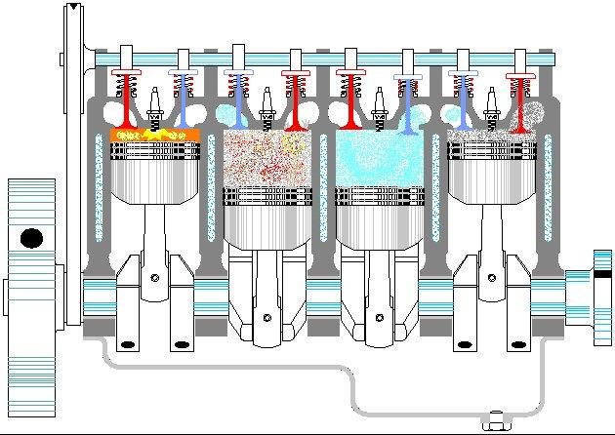
What is a RICE Unit?
EPA defines a Stationary RICE unit as:
Reciprocating
Internal
Combustion
Engine
  Reciprocating motion to convert heat energy into mechanical work
  Non-road engine as defined in 40CFR 10683.30
  Not used to propel a motor vehicle

Slide 6
What RICE Units are Impacted?
RICE applies to all existing, new & reconstructed non-road stationary reciprocating Internal Combustion Engines (CI & SI)
Except:
  Emergency Engines
    Existing or obligated to be available <15 hr/yr and not used for local reliability.
    Engine must meet subpart ZZZZ emergency engine operational requirements
  Mobile Units (non-road)
    Next slide

Slide 7
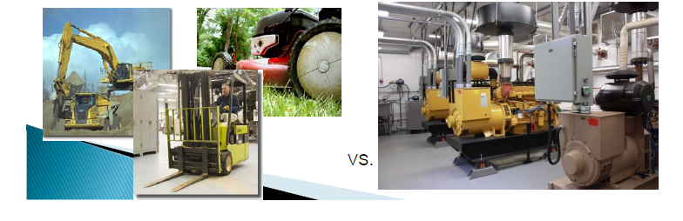
Stationary vs. Mobile
    NOT COVERED UNDER RICE: Mobile (non-road):
      Self-propelled (tractors),
      Propelled while performing their function (lawnmowers),
      Portable
        Wheels, skids, carrying handles, trailer
        Doesn’t stay in place for >12 months
          Seasonal – full annual operating period

Slide 8
Affected Sources
New
Modification
  Physical or operational change to an existing facility which increases the amount of any air pollutant emitted into the atmosphere by that facility
  Which results in the emission of any air pollutant into the atmosphere not previously emitted.
  See 40 CFR 60.14 for more information
Reconstruction
  Replacement of components of an existing facility to such an extent that the fixed capital cost of the new components exceeds 50 percent of the fixed capital cost that would be required to construct a comparable entirely new facility.
  See 40 CFR 60.15 & 63.3 for more information
    Reconstructed engines are assigned a new date of manufacture (and therefore subject to newer standards) if the fixed capital cost of the new and refurbished components exceeds 75 percent of the fixed capital cost of a comparable entirely new facility. See 40 CFR 60.4219 definition for “Date of manufacture” for more information.

Slide 9
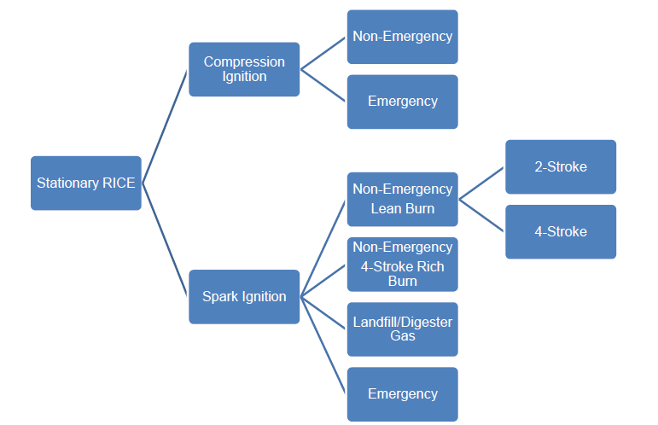
Regulations differ according to:
New or Existing
Located at an Area or Major source
Engine is Compression or Spark Ignition
  Spark is further subdivided
    2 vs. 4 stroke
    Rich or Lean burn

Slide 10
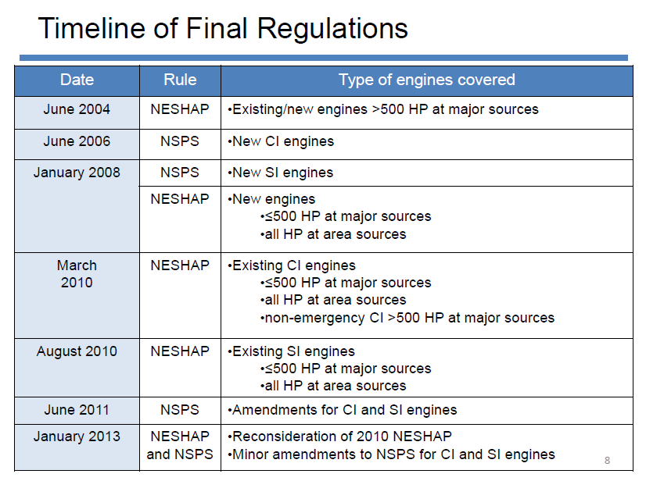

Slide 11
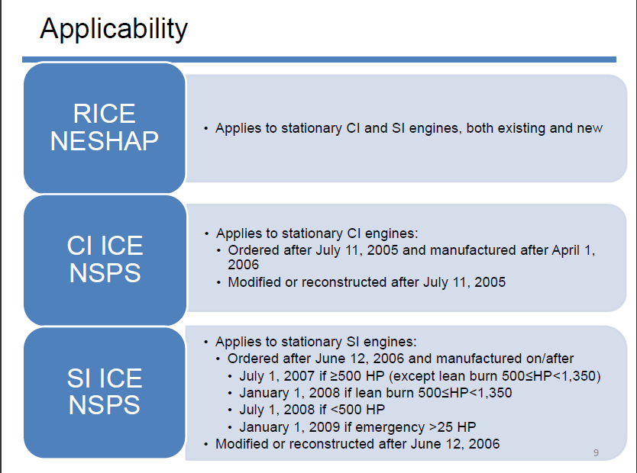

Slide 12
Requirements – NOTIFICATION
Applicability
  Non-emergency CI engines > 300 HP Installed before July 2006 (NESHAP)
  Non-emergency SI engines > 500 HP Installed before July 2007 (NESHAP);
  Non-emergency CI engines manufactured after July 2006 (NSPS)
  Non-emergency SI manufactured after July 2007 (NSPS)
Submit Letter to EPA Region with:
  Facility Name
  Engine Make/Model/Serial# & Engine Family
  Testing Requirements
  Max Engine Power/Displacement/Fuel
  Controls, if in place
  Fuel Used
  Emission Limits
Submission Date
  NSPS – due with 30 days after construction
  NESHAP – February 11, 2012 unless Tier I or II engines using BMP due March 2013
Notes:
Notify state verus EPA.
NY PA VI haven’t taken ownership of quad zzzz
WI state administering quad zz 9/1

Slide 13
RICE Requirements – Emission Limits
RICE NESHAP (CI/SI Installed before July 2006/2007)
  < 300 HP –none
  > 300 HP – Must meet CO Emission limit
    Must Submit Initial Compliance Notice by May 3, 2013 (CI), October 19, 2013 (SI)
      If compliant, maintain records and retest if engine reconstructed
      If Non-Compliant, install controls to achieve limits or reduce emissions by 70%
  > 500 HP – Must meet CO and/or formaldehyde (Major) emission limits
    Must conduct Initial stack test by May 3, 2013 (CI ) and October 19, 2013 (SI)
      If compliant, maintain records and retest every 3 yrs. or 8760 hours of operation
      If Non-Compliant, install controls to reduce emissions by 70% and retest every 3 yrs. or 8760 hours of operation
RICE NSPS (CI/SI manufactured after July 2006/2007)
  Obtain Engine Manufacturer Emissions Certificate and demonstrate compliance with NOx, CO, PM, VOC, NMHC
    If demonstrates compliance, maintain certificate
    If certificate is not available or certificate indicates exceedances:
      Conduct Stack Test within 60 days of installation to determine emissions, install controls if required and re-test to demonstrate compliance (must meet emission limit)
Notes:
CI
49 PPM – CO – 300 to 500
>500hp 23 PPM CO
70% of your fat number, or to the emission limit.
Spark

Slide 14
RICE MACT
(HAPS)
Year of Manufacture
RICE NSPS
(NOx, CO, PM, NMH)
< June 2006
> June 2006
Emergency
Yes
Emission Certification Available
No
Logs
(Install Hour Meter)
No
Maintenance
Yes
< 300 BHP-hr (CI)
< 500 BHP –hr (SI)
>300 BHP-hr (CI)
> 500 BHP –hr (SI)
Notification
(Submit within 90 days of startup)
Notification
(Submit within 90 days of startup)
Logs
Notification
Testing
Maintenance
Emissions Testing
(Submit CI – Nov 1, 2013 Submit SI – April 16, 2014)
Compliant; or
Install Controls; or
Decommission
Logs
Reporting

Slide 15
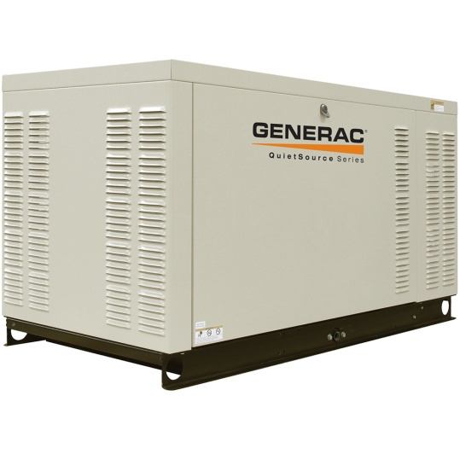
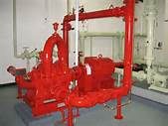
Emergency vs. Non-Emergency
RICE

Slide 16
Emergency Reciprocating Stationary Internal Combustion Engine
Any stationary internal combustion engine whose operation is limited to emergency situations and required testing and maintenance.
  Examples:
    Generators – produce power for critical operations when power from local utility is interrupted
    Fire Pumps – pump water in case of fire
Stationary CI ICE used to supply power to an electric grid or that supply power as part of a financial arrangement with another entity are not considered to be emergency engines.
  (Otherwise known as Load Shed Program)
  Changes in 2013 Amendments

Slide 17
Emergency RICE Requirements

Slide 18
Engine Manufacturer Requirements
Generators
  Required to certify 2007 model year and later non-fire pump engines with displacement <30 liters/cylinder.
Fire pump engines
  Required to certify beginning 2008 – 2011 (3 years later if rated speed is greater than 2650 rpm) according to Table 3 of Subpart IIII.
Engines with displacement > 30 liters/cylinder are not required to be certified by the manufacturer.
Owners or operators of engines which are not certified by the manufacturer must demonstrate compliance

Slide 19
Hours of Operation Limit
Operated up to 100 hours/year for M,I &T, provided the test are recommended by the Federal/State/local government, the manufacturer, the vendor, or the insurance company.
There is no time limit on the use in emergency situations.
Operate up to 50 hours per year in non-emergency situations
  but those 50 hours are counted towards the 100 hours per year provided for MIT.
  The 50 hours per year for non-emergency situations cannot be used for peak shaving or to generate income for a facility to supply power to an electric grid or otherwise supply non-emergency power as part of a financial arrangement of another entity
  For owners and operators of emergency engines, any operation other than emergency operation, maintenance and testing, and operation in non-emergency situations for 50 hours per year, as permitted in this section is prohibited.

Slide 20
Emergency ICE Hours of Operation Limit
Bottom line- now you have to track & manage your engine use to avoid exceeding usage limits under the definition of emergency
If you run your engine in excess of allowable non-emergency hours/year – you have to comply with RICE NESHAP requirements for non-emergency engines

Slide 21
Monitoring Requirements
Install - Non-resettable hour meter prior to startup of the engine.
If you are required to have a diesel particulate filter, the filter must be installed with a backpressure monitor that notifies the operator when the high backpressure limit of the engine is approached.

Slide 22
Fuel Requirements
Diesel Fuel
  Max 500 ppm sulfur
  Min cetane index of 40 or Max aromatic content of 35 volume %
10/1/2010
  Emergency Generators <30 litres/cylinder
  Sulfur content: Max 15 ppm
6/1/2012
  Emergency Generators >30 litres/cylinder
  Sulfur content: Max 1,000 ppm

Slide 23
Operate & Maintain
Annually or every 500 hours
  Change Oil & Oil Filter
  Inspect Belts
Annually or every 1,000 hours
  CI – Inspect air cleaner
  SI – Inspect spark plugs
Any additional requirements according to manufacturer’s written instructions.

Slide 24
RULE SUMMARY
Emergency Engines Install Hour Meter Operate less than: 100 hours for T/M 50 hours for Non-emergency Complete required maintenance | Engines w/ Fuel Input <300 HP (CI) <500 HP (SI) Maintenance Change Oil Inspect air filter, hoses, belts Operate/Maintain in accordance with manufacturer’s recommendations | Engines w/ Fuel Input > 300 HP (CI)² 500 HP (SI) Notify Emission Limits Initial stack test 70% reduction if does not meet limits Maintenance Required Semi-Annual Deviation Reports | CI Installed after July 2006 of SI installed after July 2007 Notify Emission Limits Manufacturer Emissions Certificate Stack Test (if not certified) to demonstrate compliance and/or required controls
NESHAP FOR RICE AREA SOURCES ¹
RICE NSPS
CI – Engines manufactured or installed before July 2006. SI Engines manufactured and installed before July 2007.
If Engines exceed 500 HP of heat input, they must conduct stack testing every 3 years or 8760 hours of operation
Notes:
Quad ZZZZ notification – possible if re-purposed from emergency to non emergency

Slide 25
Regulations
National Emission Standard for Hazardous Air Pollutants (NESHAP) for Reciprocating Internal Combustion Engines (RICE) – 40 Code of Federal Regulations Part 63, Subpart ZZZZ ("the RICE rule")
New Source Performance Standards (NSPS) - Standards of Performance for Stationary Spark Ignition Internal Combustion Engines (40 CFR Part 60 Subpart JJJJ - Scroll to reach the Subpart.) – "the Spark Ignition NSPS rule"
Standards of Performance for Stationary Compression Ignition Internal Combustion Engines (40 CFR Part 60 Subpart IIII - Scroll to reach the Subpart.) – "the Compression Ignition NSPS rule"

Slide 26
Jan. 30, 2013 Amendments
After the promulgation of the 2010 amendments, EPA received several petitions.
Amendments effective April 1, 2013
Minor amendments/clarifications also made to NSPS

Slide 27
Jan 30, 2013 Amendments – Major Issues addressed:
Emergency engine operation for demand response & peak shaving
Requirements for existing 4-stroke SI RICE at area sources of HAP
Total hydrocarbon (THC) compliance option for 4-stroke rich burn SI RICE
Tier1/Tier 2 Certified CI RICE scheduled for replacement
Tier 3 Certified CI RICE
CI RICE at area sources of HAP in remote areas of Alaska*
CI RICE on offshore vessels*
* Not covered in this presentation

Slide 28
Emergency Engine Operational Limitations
Emergency engine operation limited to:
  Unlimited use for emergencies (fire/power outage)
  100 hr/yr for MIT & Emergency demand response
  50 hr/yr of the 100 hr/yr allocation can be used for:
    Non-emergency situation, no financial arrangement
    Local reliability as part of a financial arrangement with another entity if specific criteria met (existing RICE at area sources of HAP only)
    Peak shaving until May 3, 2014 (existing RICE at area source of HAP only)
Note: EPA did not finalize the proposed 50 hr provision for peak shaving until April 2017

Slide 29
Emergency Engine Operational Limitations
Operation for emergency demand response allowed if:
  Energy Emergency Alert Level 2 has been declared by Reliability Coordinator
  Voltage or frequency deviate by 5% or more below standard
Operation for local reliability allowed if:
  Engine is dispatched by local transmission/distribution system operator
  Dispatch intended to mitigate local transmission limitations so as to avert potential voltage collapse or line overloads
  Dispatch follow reliability, emergency operation, that follow specific NERC, state/local standards or guidelines
  Power provided only to facility or to support local distro system
  Owner/operator identifies & records dispatch and standard that is being followed

Slide 30
Fuel Requirements for Emergency Engines
Requirements apply to emergency CI RICE >100 HP and displacement <30 liters/cylinder
Operated or contractually obligated to be available >15 hr/yr (up to 100 hr/yr) for emergency demand response or voltage/frequency
Operated for local reliability (up to 50 hr/yr)
Beginning 1/1/2015 – use ultra low sulfur diesel fuel
  Existing inventory may be depleted

Slide 31
Reporting Requirements for EE
RICE>100 HP
  >15hr/yr
  Operated local reliability up to 50 hr/yr
Beginning with 2015 operation – report March, 2016
  Facility name/address
  Engine rating, model year, lat/long
  Date, start time, end time for operation
  Number of hrs engine is contractually obligated for emergency demand response
  Entity that dispatched engine for local reliability
  Deviations from fuel requirement
Submit report electronically through the Compliance & Emissions Data Reporting Interface

Slide 32
SI 4-Stroke RICE>500 HP at Area Sources
Original 2010 RICE NESHAP required existing 4-stroke SI RICE >500 HP at area sources of HAP to meet emission limits for CO or Formaldehyde
2013 Amendments removed the emission limits & estabilshed the following:
  Engine in remote area must meet management practices
  Engines not in remote area must meet equipment standard & other requirements

Slide 33
Remote Definition
Located in offshore area
Located on a pipeline segment with 10 or fewer building intended for human occupancy & no building with 4 or more stories within 220 yards on either side of a continuous 1 mile length of pipeline (DOT Class 1 area), and the pipeline segment is not within 100 yards of a building or small well-defined outside area
Not located on a pipeline and having 5 or fewer buildings intended for human occupancy and no buildings with 4 or more stories within a 0.25 mile radius around the engine
Engine must meet remote definition as of 10/19/2013

Slide 34
Remote Area Source SI RICE Requirements
Existing non-emergency 4-stroke lean burn & rick burn SI RICE >500 HP at area sources of HAP that are in remote areas:
  Change oil & filter every 2160 hrs of operation or annually
  Inspect spark plugs, hoses, & belts every 2160 hrs of operation or annually & replace as necessary
Keep records of maintenance
Evaluate remote status annually & keep records
If no longer remote, comply with non-remote engine requirements within 1 year

Slide 35
Non-Remote Area Source SI RICE Requirements
Existing non-emergency 4-storke SI RICE>500 HP at area sources of HAP that are not in remote areas:
  Equipment standard requiring catalyst on engine
  4-stroke lean burn RICE: install oxidation catalyst; 93% CO reduction or 47 ppmvd CO
  4-stroke rich RICE: install non-selective catalytic reduction; 75% CO reduction, 30% THC reduction or 270 ppmvd CO
  Initial & annual catalyst activity checks
    Initial 3 15-min. runs
    Annual; 1 15-min run
  High catalyst inlet temp engine shutdown, or continuous catalyst inlet temp monitoring
  Notifications & compliance reporting
If using subpart ZZZZ Appendix A, run must be at least one measurement cycle & include at least 2 mins of test data phase measurement

Slide 36
THC Compliance Option
2004 RICE NESHAP established for formaldehyde limit for non-emergency 4SRB SI RICE >500 HP at major sources
  Either reduce formaldehyde by 76% or limit to 350ppbvd
Amendment specifies that engines meeting the 76% formaldehyde reduction standard can show compliance by demonstrating through testing that THC is reduced by at least 30%

Slide 37
Tier1/Tier 2 Certified Engines Scheduled for Replacement
2010 rule required existing non-emergency CI RICE >300 HP to comply with CO limit
►Engines would likely not comply without catalyst retrofit
►California state/local rules require CI engines certified to Tier 1 or Tier 2 standards to be replaced in next few years
►Tier 1 = model years 1996 – 2001/2002
► Tier 2 = model years 2001/2002 – 2005
► Amendment specifies that existing non-emergency CI RICE >300 HP at area sources certified to Tier 1 or 2 and subject to enforceable state/local rule that requires replacement can comply with management practices until January 1, 2015, or 12 years after the installation date of the engine, but not later than June 1, 2018
►Must submit notification by March 3, 2013, identifying state/local regulation
26

Slide 38
Tier 3 Certified Engines
Tier 3* (model year 2006) CI RICE that were constructed (installed) between January 1-June 12, 2006 are existing engines under NESHAP
►Under 2010 rule, subject to CO emission limit that would likely require catalyst retrofit
►Identical Tier 3* engine installed after June 12, 2006, does not require retrofit to comply with applicable EPA rule for that engine (NSPS)
►Amendment specifies that existing non-emergency CI RICE >300 HP at area sources certified to Tier 3* standards can comply with RICE NESHAP by complying with the CI ICE NSPS (subpart IIII)
*Tier 2 for engines >560 kW

Slide 39
Tables for Clarification

Slide 40
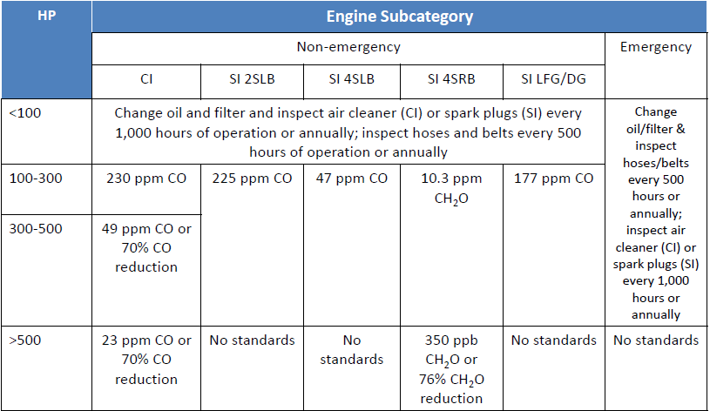
Emission Standard: Existing RICE Located at Major Sources

Slide 41
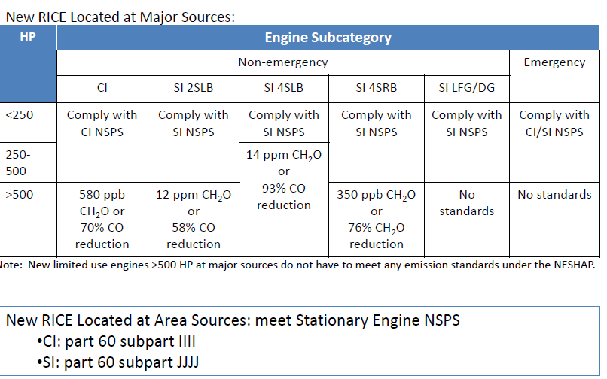
Emission Standards – New RICE

